Slide 1
Titanic Survival Prediction
Machabe Tshabalala
25/03/2025

Slide 2
Introduction
Project: Titanic Survival Prediction
Goal: To predict whether a passenger survived the Titanic disaster, based on their attributes.
Dataset: The Titanic dataset from Kaggle (train.csv).

Slide 3
Data Collection
Source of the data: The Titanic dataset from Kaggle (train.csv).
Data columns (total 16 columns):
# Column Non-Null Count Dtype
--- ------ -------------- -----
0 PassengerId 891 non-null int64
1 Survived 891 non-null int64
2 Name 891 non-null object
3 Sex 891 non-null int64
4 Age 891 non-null float64
5 SibSp 891 non-null int64
6 Parch 891 non-null int64
7 Ticket 891 non-null object
8 Fare 891 non-null float64
9 Cabin 204 non-null object
10 FamilySize 891 non-null int64
11 IsAlone 891 non-null int64
12 Pclass_2 891 non-null bool
13 Pclass_3 891 non-null bool
14 Embarked_Q 891 non-null bool
15 Embarked_S 891 non-null bool
dtypes: bool(4), float64(2), int64(7), object(3)
memory usage: 87.1+ KB

Slide 4
Data Preprocessing and Cleaning
# Handle missing ages
imputer = SimpleImputer(strategy='median')
df['Age'] = imputer.fit_transform(df[['Age’]])
# Handle missing Embarked
df['Embarked'] = df['Embarked'].fillna(df['Embarked'].mode()[0])
# Feature Engineering
df['FamilySize'] = df['SibSp'] + df['Parch'] + 1
df['IsAlone'] = (df['FamilySize'] == 1).astype(int)

Slide 5


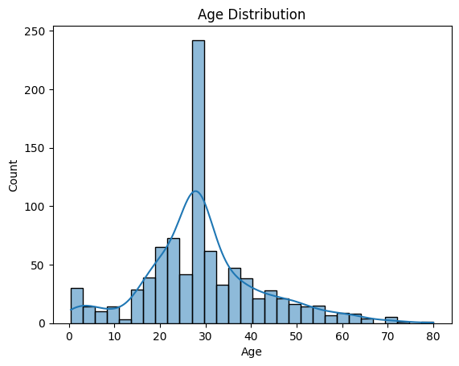
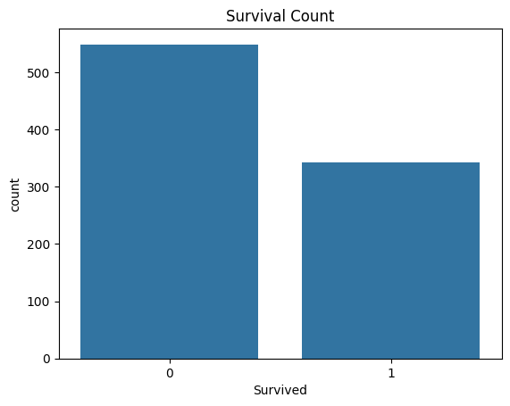
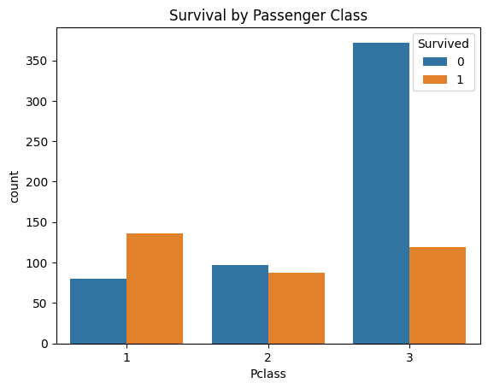
Exploratory Data Analysis

Slide 6
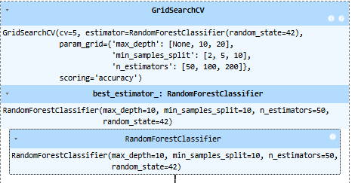
Modeling
grid_search = GridSearchCV(model, param_grid, cv=5, scoring='accuracy')
grid_search.fit(X_train, y_train)

Slide 7
Model Evaluation
Accuracy: 0.8491620111731844
precision recall f1-score support
0 0.84 0.91 0.88 105
1 0.86 0.76 0.81 74
accuracy 0.85 179
macro avg 0.85 0.84 0.84 179
weighted avg 0.85 0.85 0.85 179
[[96 9]
[18 56]]

Slide 8
Recommendations and Conclusion
Feature Importance:
Sex 0.403089
Fare 0.208461
Age 0.159118
Pclass_3 0.099092
FamilySize 0.062025
Embarked_S 0.024764
Pclass_2 0.021386
IsAlone 0.014374
Embarked_Q 0.007691

Slide 9
Recommendations and Conclusion
Recommendations based on Feature Importance:
- Gender was a significant factor. Prioritize female passengers in evacuation.
- Age influenced survival. Consider prioritizing children and the elderly.
- Family size played a role. Consider keeping families together during evacuation.

